Slide 1
Best Practices to Reduce Your Risk of Developing a Cumulative Trauma Injury
Special Emphasis on Employees Who are Young or Newly Hired

Slide 2
Disclaimer
This material was produced under grant number SH-99053-SH0 from the Occupational Safety and Health Administration, U.S. Department of Labor. It does not necessarily reflect the views or policies of the U.S. Department of Labor, nor does mention of trade names, commercial products, or organizations imply endorsement by the U.S. Government.

Slide 3
Training Topics Reducing Risk of Cumulative Trauma
Why focus on young and newly hired employees?
What causes cumulative trauma, pain, and injury?
How to keep yourself safe and healthy, especially if you are young or a new hire

Slide 4
Why Focus on Young and Newly Hired Employees?
Reasons for Training

Slide 5
Who is Considered a Young Employee?
Usually defined as up to 25 years old

Slide 6
Who is Considered a “New” Employee?
Usually defined as on the job for less than one year
Represents about 20% of the workforce*
* Bureau of Labor Statistics, 2020

Slide 7
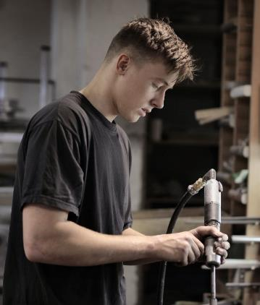
Young Employees are More Likely to Get Injured
“If you’re under 25, you’re more likely to get injured on the job than if you’re over 25.”
More than 50% of accidents involving younger workers occur during the first six months on job

Slide 8
Why are Young Employees More Likely to Get Injured?
Work-related reasons
Lack of training and work experience
Not prepared for job’s physical demands
More likely to be given riskier jobs
Misunderstand or are unaware of employee rights

Slide 9
Why are Young Employees More Likely to Get Injured?
Individual perceptions and attitudes
Feel invincible
More likely to take risks or do activities without knowing the consequences
Less-motivated to find out if an activity is risky
More easily distracted
Hesitant to ask questions
L

Slide 10
Newly Hired Employees are More Likely to Get Injured
Questions: Which new hires are more likely to get injured?
On job for <1 month | or | On job for 1+ years
Males | or | Females
Young employees | or | Older employees
Recent immigrants | or | Established immigrants

Slide 11
Newly Hired Employees are More Likely to Get Injured
Answers: Which new hires are more likely to get injured?
On job for <1 month | or | On job for 1+ years
Males | or | Females
Young employees | or | Older employees
Recent immigrants | or | Established immigrants
4x!

Slide 12
Why are Newly Hired Employees More Likely to Get Injured?
Not yet adjusted to the demands of the job
Not yet learned how to do job in a way that lowers physical stress on the body
More likely to develop symptoms of discomfort
L

Slide 13
What Can Cause Cumulative Trauma, Pain, or Injury?
Understanding how Injuries Occur

Slide 14
What are Cumulative Trauma Injuries?
Acute injuries can occur following a single high-impact event
vs.
Cumulative trauma injuries build up over time
Examples:
Broken Bone
Laceration
L
Focus of this training
Examples:
Elbow Soreness
Back Pain

Slide 15
What Can Cause Cumulative Trauma, Pain, or Injury?
Lifting heavy weight or exerting high forces
L
Examples:
Lifting or Carrying
Pushing or Pulling
Exerting Strong Grips

Slide 16
What Can Cause Cumulative Trauma, Pain, or Injury?
Lifting heavy weight or exerting high forces
This is a risk factor because:
Muscles generate the effort we need to perform a task
The amount of effort needed depends on:
The amount of weight / force handled, and
The way that the weight / force exerted
Muscle effort is usually much greater than the weight / force needed for the task
Even small increases in weight / force or the reach to perform a task greatly increases the effort required
Examples:
Light
Muscle Effort
Light
Muscle Effort
Heavy
Muscle Effort
Far from Body
Close to Body
Close to Body

Slide 17
What Can Cause Cumulative Trauma, Pain, or Injury?
Lifting heavy weight or exerting high forces
This is a risk factor because:
Muscles generate the effort we need to perform a task
The amount of effort needed depends on:
The amount of weight / force handled, and
The way that the weight / force exerted
Muscle effort is usually much greater than the weight / force needed for the task
Even small increases in weight / force or the reach to perform a task greatly increases the effort required
Examples:
15#
40#
20#
Lifting 40 lbs. close to the body
Lifting 20 lbs. mid-way from the body
Lifting 15 lbs. at arm’s length from the body
These lifting tasks each put about the same amount of stress on the back

Slide 18
What Can Cause Cumulative Trauma, Pain, or Injury?
Working in awkward body postures
Examples:
Bending Forward
Reaching Overhead
Bending Wrists

Slide 19
What Can Cause Cumulative Trauma, Pain, or Injury?
Working in awkward body postures
Shoulders
Examples:
Wrists
This is a risk factor because:
Muscles become weaker as postures become more awkward
75%
77%
100%
Amount of muscle strength:
100%
93%
60%
88%
83%

Slide 20
What Can Cause Cumulative Trauma, Pain, or Injury?
Repetitively using the same body part
Examples:
Frequent Lifting
Constant Reaching
Rapid Use of Hands & Wrists

Slide 21
What Can Cause Cumulative Trauma, Pain, or Injury?
Repetitively using the same body part
This is a risk factor because:
Over a period of time, the body has less ability to withstand the demands of the job if there is not enough recovery time
Amount of cumulative trauma that does not lead to injury
Work Demands < Tolerance
Amount of cumulative trauma that does not lead to injury
Work Demands < Tolerance
Work Demands > Tolerance

Slide 22
What are Symptoms of Cumulative Trauma?
Indications of Wear and Tear on the Body

Slide 23
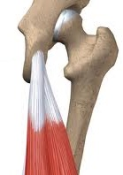
Symptoms of Cumulative Trauma Muscles
Symptoms
Weakness, fatigue
Pain, tenderness
Spasms
Likely locations:
There is a lot of blood flow to our muscles, so they can recover from injury very quickly
Muscles generate force when they contract
Back
Neck

Slide 24
Symptoms of Cumulative Trauma Tendons
Symptoms
Dull ache that doesn’t go away
Swelling, tenderness
Discomfort when moving in specific ways
Likely locations:
There is not much blood flow that flows to our tendons, so they can take a long time to recover
Tendons connect all muscles to bones
Shoulder
Elbow
Knee

Slide 25
Symptoms of Cumulative Trauma Nerves (example: carpal tunnel syndrome)
Signs of initial trauma
Numbness and tingling in the hands
Pain at night
Signs of longer-term trauma
Weakness
Problems holding objects
Likely locations:
Nerves send sensations and impulses through the body
Hand & Wrist

Slide 26
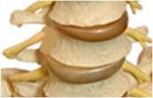
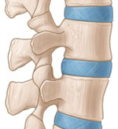
Symptoms of Cumulative Trauma Discs in the Back
L
Initial trauma
None! (nothing can be felt when damage first occurs)
Longer-term trauma
Disc damage affects nerves
Pain going down the leg
Numbness, tingling
Spinal Discs are the “shock absorbers” between vertebrae

Slide 27
How Do You Reduce Your Risk of Cumulative Trauma?
Approaches to Protect Yourself from Injury

Slide 28
Lowering Cumulative Trauma Risk Reduce Muscle Effort & Stress on Body
Examples:
Get your body as close to the load as possible before picking it up
“Lift with your legs, not your back” is not a good strategy if your knees cause you to lift with the load further away from your body
When possible, straddle the load so that you can lift and handle it closer to your body

Slide 29
Lowering Cumulative Trauma Risk Reduce Muscle Effort & Stress on Body
Examples:
Carry items in front of the body
When possible, balance items handled between sides of the body
Ask for help when lifting heavy objects
L
Allows both sides of the body to equally support the load
L
Allows both sides of the body to equally support the load
Divides effort between individuals

Slide 30
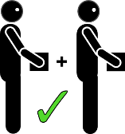
Lowering Cumulative Trauma Risk Reduce Muscle Effort & Stress on Body
Examples:
Get your body as close to the load as possible before picking it up
For heavy loads, make more trips with less weight, when possible
Less reaching to pick up a load is safer for the back and shoulders
This practice is nearly always safer for the back

Slide 31
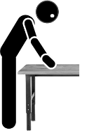
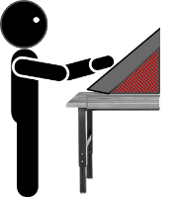
Lowering Cumulative Trauma Risk Work in Stronger Body Postures
Examples:
Adjust the height of your work
Adjust the position of your work
Be creative in finding ways to work while standing in an upright position
Angle your work to reduce wrist bending

Slide 32
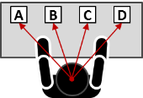
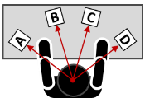
Lowering Cumulative Trauma Risk Work in Stronger Body Postures
Examples:
Push wheeled containers rather than pull them
Arrange most-used items to be within arm’s length
Allows both sides of the body to equally exert the effort needed
Reduces over-reaching and stress on the shoulders

Slide 33
Lowering Cumulative Trauma Risk Recover from Repetitive Tasks during Work
Periodically do simple repetitive activities with your non-dominant hand
Provides “micro” rest breaks for the most-used body parts
Task done by opposite side of the body

Slide 34
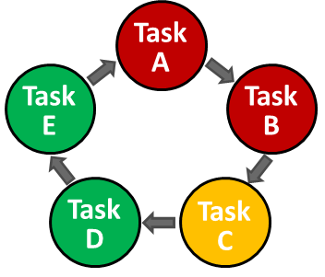
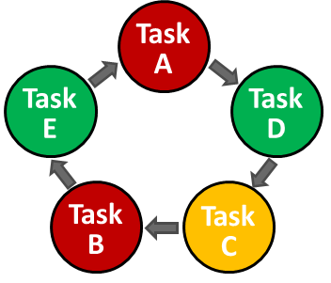
Lowering Cumulative Trauma Risk Recover from Repetitive Tasks during Work
When possible, create ways to spread out high-demand activities among other required tasks
Intermixing easier physical work within higher-effort tasks provides more opportunities for rest

Slide 35
Lowering Cumulative Trauma Risk Other Ways
Prepare for job tasks, by warming up your body
Back: Do you bend, lift, push, pull?
Arms: Do you reach?
Hands: Do you grip, type, perform rapid movements?
L
L
L
L
L
L
L
L
L

Slide 36
Lowering Cumulative Trauma Risk Other Ways
Communicate your job improvement ideas to others you work with
Coworkers
Supervisor
L
L
L
L
L
L
As a young or newly hired employee, you may notice ways to make the work easier that longer-term employees have not considered

Slide 37
Lowering Cumulative Trauma Risk As a Young Employee…
?
Do not be afraid to ask questions about job
Obvious risks to others may not be obvious to you
Find a more-senior employee to provide guidance
They can offer job tips not covered in training
Reduce exposure to possible distractions
Working safely may require more attention than you are used to
talk
Talk
TALK
L
STOP

Slide 38
Lowering Cumulative Trauma Risk As a Newly Hired Employee…
Be clear about all workplace safety risks
Supervisor might assume you know these from past jobs
Report discomfort / pain that does not go away
New-hires often do more physically demanding jobs
Be sure you fully understand all safety signs and rules
Are they provided in your preferred language?

Slide 39
Take-Home Messages

Slide 40
What to Remember
Young and newly hired employees are at an increased risk of injury when starting a new job
Cumulative trauma from work can cause injuries that are painful and long-lasting
Most cumulative trauma injuries have recognizable symptoms and should be reported
All employees have the ability to use work techniques that reduce their injury risk

